Slide 1
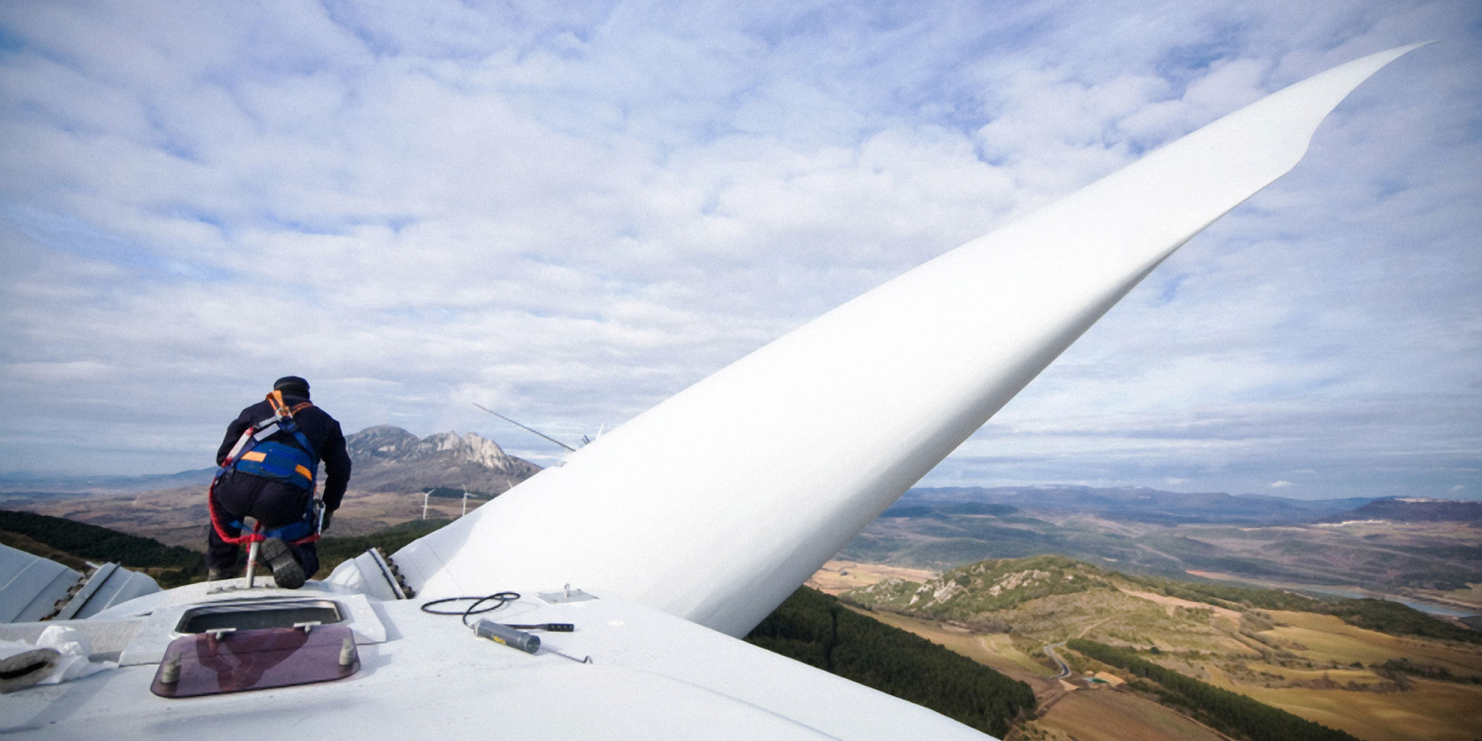

Tim Buckley - Arkx Clean Energy Presentation
NY Society of Security Analysts − November 2013
Notes:
Good afternoon
My name is Tim Buckley, for the last four years I have been a portfolio manager for the Sydney based firm of Arkx, a specialist investor in large, global listed clean energy firms.
I’ll focus my introductory comments on four points:
Fossil fuels are Inflationary; Renewable Energy is Deflationary.
India’s Electricity System is dominated by Thermal capacity, and the country’s entire energy structure is fundamentally flawed.
India has a well established base of distributed Renewable Energy – Hydro, Run-of-River, Solar, Wind and Biomass; and it is already cost competitive with unsubsidised thermal. Wind PPAs are Rs4.60/w, below PPAs for new thermal projects, and solar is rapidly coming down; wholesale parity by 2016.
There are some strong plans for RE from the Indian Government with increasing Corporate support.
I have a lot of slides, so I’ll go very quickly to get through this presentation in 15 minutes.

Slide 2
#1. Fossil fuels are inflationary
Notes:
For the last few decades, fossil fuels have been a major inflationary factor across the global. Accepting some regional variances, oil, coal and gas prices have all been rising. Fossil fuels have been an inflationary force globally.
Shale gas in the US has been revolutionary in its economic impact. However, at US$3-4/MMBTU – this is not reflective of world gas prices – US$15 in Japan & US$10-12 in EU. Australia has been paying US$3-4, but is set to go to US$8 by 2016.

Slide 3
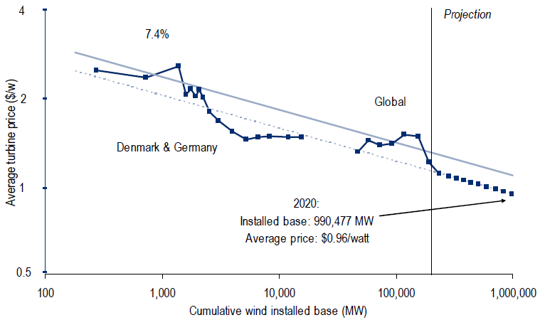
Renewable energy has proven strongly deflationary
Source: Bloomberg New Energy Finance, Citi Research
Notes:
Deflation trends in renewable energy is driven by increasing economies of scale and continued technology improvements.
Deflation in the onshore wind sector is a long established trend spanning four decades. This chart details the learning curve, showing unit prices have fallen 7% with every doubling of installed capacity since 1970.

Slide 4
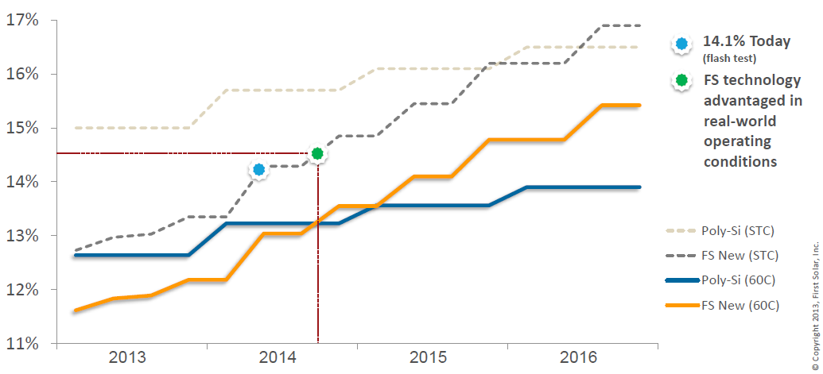
First Solar’s thin-film vs Si-PV solar module efficiency (normalised for temperature)
Source: First Solar 3Q2013 Result Presentation (31 Oct 2013); BNEF
Notes:
Solar has already achieved transformational technology progress, but more is still to come.
This chart comes from First Solar’s 3Q2013 result earlier this month.
First Solar is the largest solar firm in the world, and it focuses and dominates a niche in the solar market: a non-silicon based thin-film solar for utility scale projects. The grey dashed line details the significant technology improvements in terms of conversion efficiency of thin-film solar – rising from 13% at the end of 2012 to 14.0% today to a Corporate target of 17% by end 2016. Polysilicon based PV modules currently have a higher conversion efficiency of 15-16%, but First Solar expects to overtake PV by 2016 for higher temperature applications e.g. utility scale projects in the desert!

Slide 5
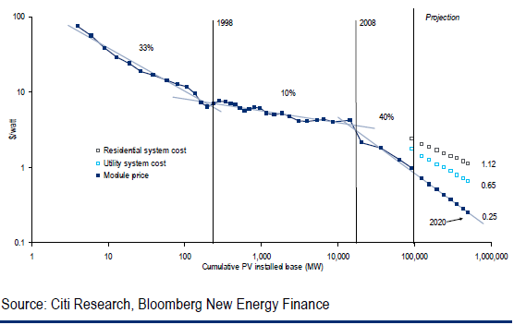
Economies of scale & Technology gains = Dramatic cost down for solar: 1978 through to 2020
Notes:
I lifted this modelling from a Citigroup Equity Research report from earlier this year. Citi shows the combination of economies of scale and technology gain have seen solar costs / watt drop dramatically over time, but that this trend has accelerated in the last five years, suggesting a cost of a solar module might hit US$0.25-0.45/w by 2020 – giving an installed cost of well under US$1m/MW. Aggressive, but on track in the last three years.

Slide 6
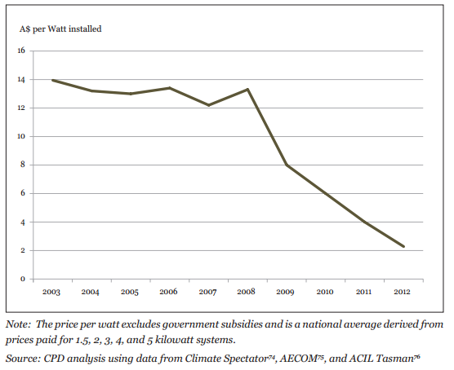
Economies of scale & Technology gains = Dramatic cost down for solar: 2003-2012 (Installed Rooftop PV, Australia)
Notes:
Last point on renewables being deflationary.
Installed cost on a rooftop in Australia over the last decade – already down to A$2m/MW in 2012.
Wind and Solar coupled with Hydro and Biomass are having a massive deflationary impact on the electricity sector. German wholesale electricity prices are at a decade low in 2013, same with Australia.

Slide 7
There is a massive investment in renewable energy globally
GW
Solar +185 GW in the period 2011-15
Wind +200 GW in the period 2011-15
Source: EPIA; GWEC; IEA Hydro forecasts; Arkx forecasts
Notes:
The opportunity in renewable energy is enormous, and growing rapidly.
Almost 400 GW of solar and wind will be installed over 2011-2015 globally – over 500 GW if hydro is included.

Slide 8
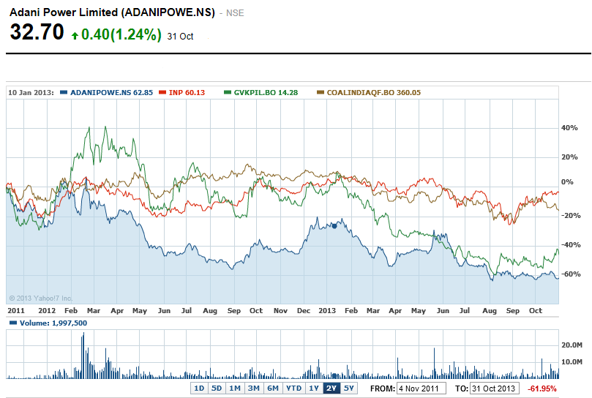
#2. The Indian Power Sector is fundamentally flawed
Source: Yahoo.com
Notes:
The Indian power generation sector has seem profit margins smashed, balance sheets are generally badly over-leveraged and most participants are part-way through funding multi-billion dollar capacity expansions on projects that are uneconomic – struck on long term PPAs with only partial CPI indexation at rates around or below Rs3/kW - well below market rates, often rates below the cost of the coal inputs.
As a result, the sector has significantly underperformed the Indian market overall eg GVK -40% over two years, Adani Power down 60% in the same period.
Tata Power’s new 4GW Mundra coal-fired power station is losing money to the point where the group is talking about walking away from the facility, while China Light & Power’s two Indian facilities – the 1.3 GW Jhajjar coal-fired plant and the 665MW gas-based power plant in Gujarat are both loss-making due primarily to fuel-supply constraints.

Slide 9
“RBI to banks: Take call on stressed sector exposure”
"The Reserve Bank has made it clear that it will not be intervening in the issue of fresh exposure by lenders. The position taken by the banking regulator is that, for now, it is up to the banks to take a business decision on a case-by-case basis. If the Electricity Boards come up with a credible plan for restructuring and for servicing the loan that they take, banks have been asked to resume loan disbursements”. In states where the utilities are yet to come up with a restructuring plan, banks have been advised to consider suspending the lines of credit.
Indian Express - Feb 2012
Notes:
The Reserve Bank of India is warning the banking sector to limit financing for the power generators.
To-date, this is a call that has been ignored, but clearly the domestic Indian banking sector cant afford to take on more troubled loan exposures to the fossil fuel generation sector.

Slide 10
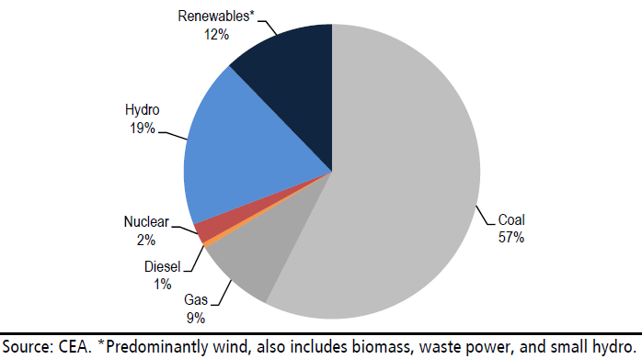
India needs a stronger, more diverse electricity system (Electricity Capacity, as at Jan’2013)
Notes:
India has what appears to be a somewhat diversified electricity structure, when examined in terms of installed capacity.
However, with solar operating rates of 20%, wind at 25% and Hydro at 30% - this is a false picture of diversity, particularly with Gas being 9% of capacity, but operating rates here dropping massively…..

Slide 11
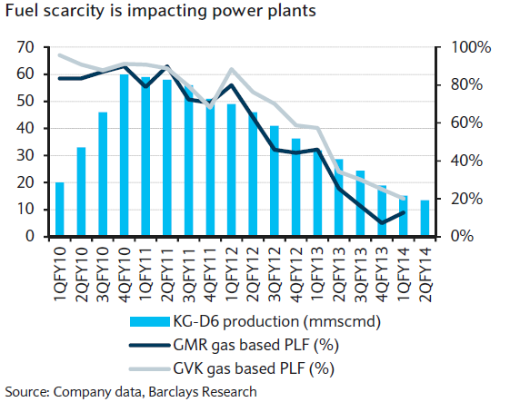
Gas-fired electricity sector is not delivering
Notes:
India has made a big push to build up significant gas-fired electrical capacity only to have their main gas field’s production curtailed well before it was forecast. Gas power plants have seen operating rates plummet from 80% to 20% in the last three years, with no sign of a turnaround.

Slide 12
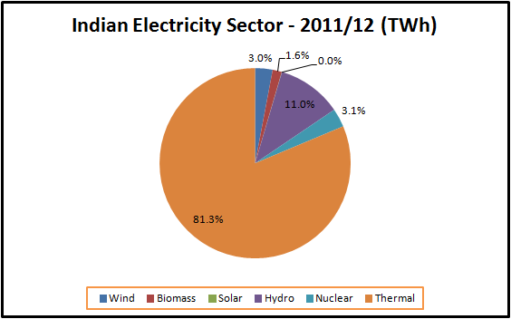
India needs a stronger, more diverse electricity system
(Electricity production rather than capacity)
Notes:
So – when the generation system is viewed in terms of electricity production, the Indian system is predominantly coal fired.
Traditionally reliant on a domestic coal supply. But coal imports have doubled to 20% of India’s total thermal coal consumption in only 4 years due to an inability to overcome domestic production barriers.
For a number of reasons – from energy security, massive fossil fuel imports causing a CAD and hence depreciating currency, through to water stress and pollution, India needs to build its energy diversity.

Slide 13
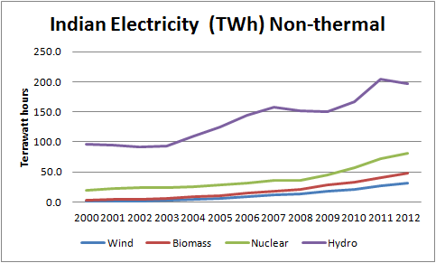
#3. Indian non-thermal electricity capacity is building
Source: BP Statistical Review of World Energy June 2013
Notes:
So, onto Point #3 => There are some signs of change in India.

Slide 14
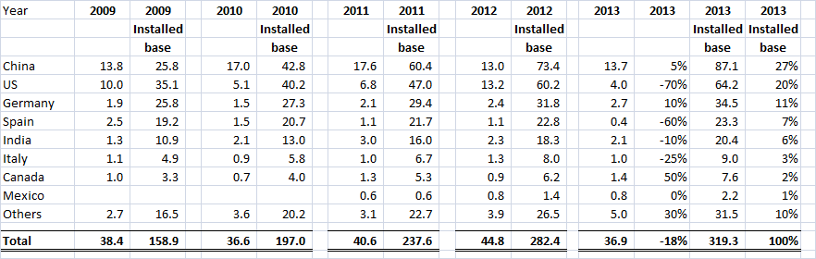
#3. India – An electricity capacity transformation is possible
India is already the #5 wind market in the world
Source: WWEA actuals, Arkx Investment Management estimates
Notes:
India has a substantial wind resource – with untapped potential of 75 GW on top of the 20 GW of installed wind farm capacity.

Slide 15
#3. India – An electricity capacity transformation is possible
India is already the #5 wind market in the world
Source: WWEA actuals, Arkx Investment Management estimates
Notes:
India is already the #5 wind market in the world in terms of total installed capacity, and #4 in terms of annual additions of 2-3GW.

Slide 16
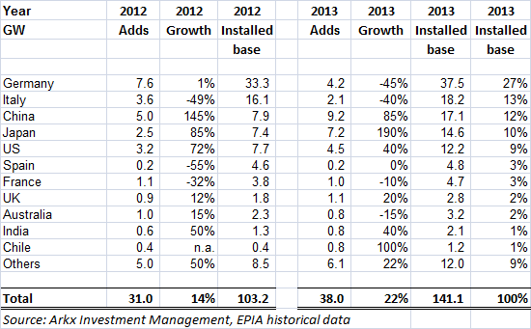
#3. India – An electricity capacity transformation is possible
India’s solar capacity is rising, but a long way to go
Notes:
Solar has seen very strong growth, but off a very small base – there is huge scope to ratchet up annual solar installs from current levels of below 1GW pa.
India is #10 in world rankings of total installed capacity – but most of this has been built in just the last two years. Ambitions are rising rapidly.

Slide 17
#4. India – An electricity system transformation is possible
a. The Government is willing
Ministry of New and Renewable Energy
Solar – target to raise total installs 8-fold by 2017, and is considering a upfront cash grant system of 30-40% of total capital cost, like the US. Talk of over 2 GW of solar installs in 2014.
  solar FiTs down 63% in just three years, with current tariffs average at Rs7.7/kWh, with some under Rs6/kWh
Wind – A target to install 15GW of wind in the next 5 years. Current regulations are supportive, with wind price competitive already.
Notes:
The Indian government established the “Ministry of New and Renewable Energy” (MNRE) with some very progressive policies in place to leverage up installations of renewables.
The MNRE has established a National Solar Mission, aiming to leverage the high solar insolation, the strong grid and readily available government landbanks.
An interesting perspective is that all of India’s electricity needs could be generated if solar was established on just 5% of the nation’s unused desert lands.
With Phase I of the solar mission complete, average solar FiTs have declined 63% in just three years, with current tariffs at Rs7.7/kWh.
However, like Australia and America, stop-start policy has been a serious impediment. India is proposing some purchase obligations for state distribution companies.

Slide 18
#4. India – An electricity system transformation is possible
b. Industry is willing, and partnerships are expanding
China Light & Power (HK listed)
  1,000 MW of wind farms within 12-18 months
Greenko (UK listed)
  backed by Singapore GIC – targets 1,000MW Wind/Hydro by 2015
Mytrah Energy (AIM listed)
  16% owned by Capital/Hendersons/Blackrock – targets 1,375MW Wind by 2015
Continuum Wind Energy
  Backed by Morgan Stanley
ReNew Wind Power
  Owned by Goldman Sachs, US$385m invested
Welspun Energy
  Backed by Welspun Corp. of India (listed) – targets 1,700 MW of Wind & Solar by 2017
Sulzon (India) and Gamesa (Spain)
  both have huge Indian turbine capacity – over 4GW pa capacity in place
Sambhar Ultra Green Solar Power Project
  BHEL, Solar Energy Corp of India, Power Grid Corp, Rajastan Electronics – 4GW by 2020
NHPC (India)
  A listed hydro generator – 2,470MW underconstruction
Notes:
I wont go through this list – but there is a growing base of established and proven operators in India, most with an international tie to access global equity support, and each has very strong ambitions to build out additional renewable capacity.

Slide 19
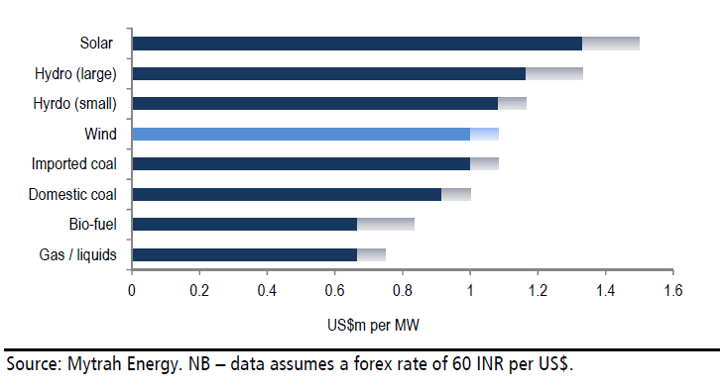
#4. India – An electricity capacity transformation is possible
c. Costs for renewables are very competitive (US$/MW installed)
Notes:
Very low land costs and cheap labour, plus very price competitive turbines means a total install cost of ~US$1m/MW – lowest in the world, and very competitive with new fossil fuel capacity. Better still – 100% domestic Rupee capital and running costs – ideal for helping reversing the massive and growing fossil fuel derived current account deficit.
Solar is still ~50% above wholesale grid parity, but rapidly coming down. MNRE and a number of other financial analysts have predicted grid parity by 2016-17. However, for distributed solar, it is already close to retail grid parity for end customers.

Slide 20
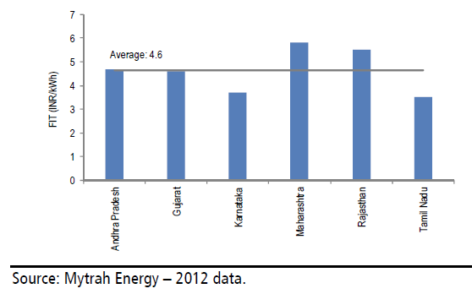
#4. India – An electricity system transformation is possible
c. Renewables are competitive - Wind FiT averages Rs4.6/kWh
Notes:
The current FiT for wind is Rs4.6/kWh (US7.5c), only just above the current merchant rate that averages R4.5/kWh. So while solar is still at Rs7.7/kWh (albeit dropping fast), wholesale wind is cost competitive now.
Wind farm utilisation rates average 25%, so in line with the EU, but below US & Brazil, probably reflective of a focus on low cost rather than best technology.
“Group captive schemes” are allowing PPAs with end users at higher FiTs.
Better still, most Indian PPAs are either fixed price, or fixed price with a small escalator as a % of CPI. As such, once a windfarm is built, the tariff is fixed for 20-25 years – deflationary!

Slide 21
Four points:
1. Renewables are deflationary
2. The Indian Electricity system needs energy diversity
3. The regulatory and corporate structure is largely in place
4. There is real progress being made to build out already cost competitive Renewable Energy projects
Questions?
India – An electricity system transformation is possible

Slide 22
1. Access to financial capital
- debt, mezzanine and equity
- domestic and international
2. Removal of subsidies for fossil fuels
3. Development of distributed solar with storage
4. The regulatory policy stability and a greater political will
- a need to reduce the bias towards incumbents
- reduce permitting and construction delays
- Reform of the State Electricity Boards
(or Federal guarantee of RE PPAs to make them bankable)
India – Key constraints to renewable energy deployment

Slide 23
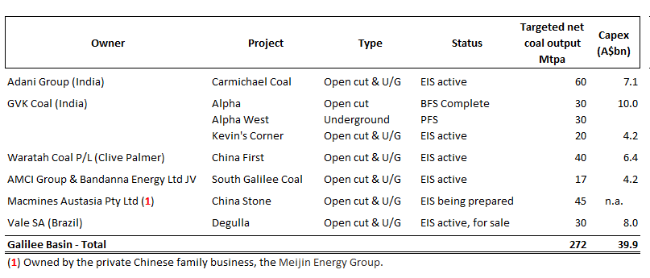
Stranded II – Adani’s Carmichael Project in the Galilee Basin
Notes:
So – when the generation system is viewed in terms of electricity production, the Indian system is predominantly coal fired.
Traditionally reliant on a domestic coal supply. But coal imports have doubled to 20% of India’s total thermal coal consumption in only 4 years due to an inability to overcome domestic production barriers.
For a number of reasons – from energy security, massive fossil fuel imports causing a CAD and hence depreciating currency, through to water stress and pollution, India needs to build its energy diversity.

Slide 24
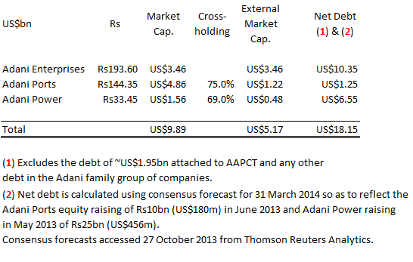
Stranded II – Adani’s Equity vs Debt Capitalisation
Notes:
So – when the generation system is viewed in terms of electricity production, the Indian system is predominantly coal fired.
Traditionally reliant on a domestic coal supply. But coal imports have doubled to 20% of India’s total thermal coal consumption in only 4 years due to an inability to overcome domestic production barriers.
For a number of reasons – from energy security, massive fossil fuel imports causing a CAD and hence depreciating currency, through to water stress and pollution, India needs to build its energy diversity.

Slide 25
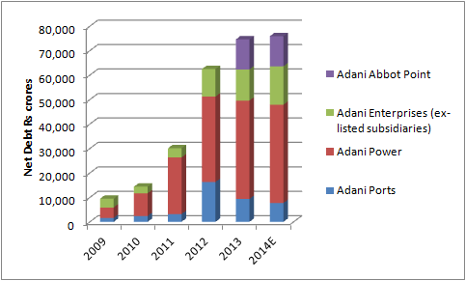
Stranded II – Adani’s Carmichael Project in the Galilee Basin
Source: Adani Group’s listed company annual reports, Thomson One Analytics consensus forecast (Oct’2013)
Notes:
So – when the generation system is viewed in terms of electricity production, the Indian system is predominantly coal fired.
Traditionally reliant on a domestic coal supply. But coal imports have doubled to 20% of India’s total thermal coal consumption in only 4 years due to an inability to overcome domestic production barriers.
For a number of reasons – from energy security, massive fossil fuel imports causing a CAD and hence depreciating currency, through to water stress and pollution, India needs to build its energy diversity.

Slide 26
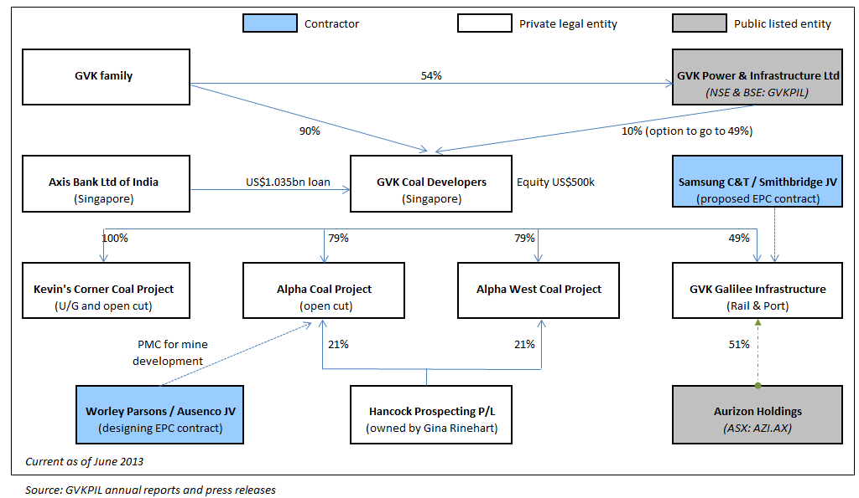
Stranded I – GVK’s Alpha Project in the Galilee Basin
Notes:
So – when the generation system is viewed in terms of electricity production, the Indian system is predominantly coal fired.
Traditionally reliant on a domestic coal supply. But coal imports have doubled to 20% of India’s total thermal coal consumption in only 4 years due to an inability to overcome domestic production barriers.
For a number of reasons – from energy security, massive fossil fuel imports causing a CAD and hence depreciating currency, through to water stress and pollution, India needs to build its energy diversity.

Slide 27
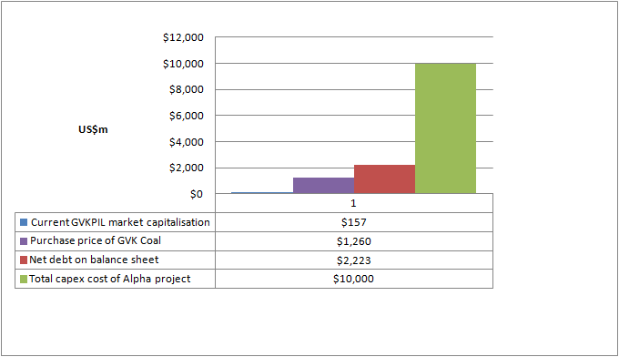
Stranded I – GVK’s Alpha Project in the Galilee Basin
Notes:
So – when the generation system is viewed in terms of electricity production, the Indian system is predominantly coal fired.
Traditionally reliant on a domestic coal supply. But coal imports have doubled to 20% of India’s total thermal coal consumption in only 4 years due to an inability to overcome domestic production barriers.
For a number of reasons – from energy security, massive fossil fuel imports causing a CAD and hence depreciating currency, through to water stress and pollution, India needs to build its energy diversity.

Slide 28
Disclaimer and Terms of Use
This report was produced for the Institute for Energy Economics and Financial Analysis (IEEFA) , a not-for-profit research Institution organized under Internal Revenue Code 501(c)(3) of the United States.
The authors of this presentation are not brokers, dealers or registered investment advisors and do not attempt or intend to influence the purchase or sale of any security.
This presentation is intended for informational and educational purposes only. This presentation is not a solicitation, an offer, a recommendation to buy, hold, or sell any securities, products, service, investment or participate in any particular trading scheme in any jurisdiction. The presentation is not and shall not be used as part of any prospectus, offering memorandum or other disclosure attributable to any issuer of securities. No individual or entity is authorized to use the information contained herein for the purpose or with the effect of incorporating any such information into any disclosure intended for any investor or potential investor. This presentation is not intended, in part or in whole, as financial advice.
The information and opinions in the presentation constitute a judgment as at the date of the presentation and are subject to change without notice. The information and opinions contained have been compiled or arrived at from sources believed to be reliable and in good faith, but the authors do not represent and make no warranty, express or implied, as to the accuracy, completeness or correctness contained in this presentation. The authors do not warrant that the information is up to date. All information provided expressly disclaims any and all warranties, express or implied, including without limitation warranties of satisfactory quality and fitness for a particular purpose with respect to the information contained herein.
All information contained herein is protected by law, including but not limited to Copyright Law, and none of the information contained herein is to be copied or otherwise reproduced, repackaged further transmitted, transferred, or redistributed for subsequent use for any such purpose in whole or in part, in any form or manner or by any means whatsoever, by any person without prior written consent from the authors.
JURISDICTION
The authors do not make any representations that the use of information contained herein is appropriate for use in other locations or that may access this information from outside of the United States.
This document is not directed to, or intended for distribution to or use by, any person or entity who is a citizen or resident of or located in any locality, state country or other jurisdiction where such distribution, publication, availability or use would be contrary to law or regulation or would subject the Institute to any registration or licensing agreement within such jurisdiction.
Notes:
.

